Slide 1
Graph Transformer via ResNet SimCLR for WSI Colon Classification
Bryan Wong
2021/01/17

Slide 2
Overview
Using the WSI-level label on each patch during training is not an ideal choice -> need to process both the local information as well as the WSI to better understand the pathologist correlates of disease
Pathologists often zoom in and out of specific regions of interest to assess various aspects of disease at multiple scales
Graph-based approaches have gained a lot of traction due to their ability to represent entire WSI and analyze patterns to predict various outcomes of interest

Slide 3
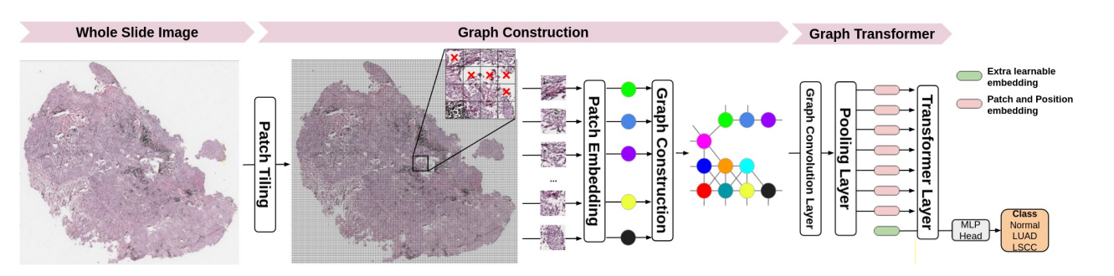
Steps Overview
Step 1: Patch Tiling
Step 2: Training Patch Feature Extractor
Step 3: Constructing Graph
Step 4: Training Graph Transformer
Step 5: Visualization (in progress)
Yi Zheng, Rushin Gindra, Margrit Betke, Jennifer E.Beane, Vijaya B. Kolachama. “A deep learning based graph-transformer for whole slide image classification” (2021)

Slide 4
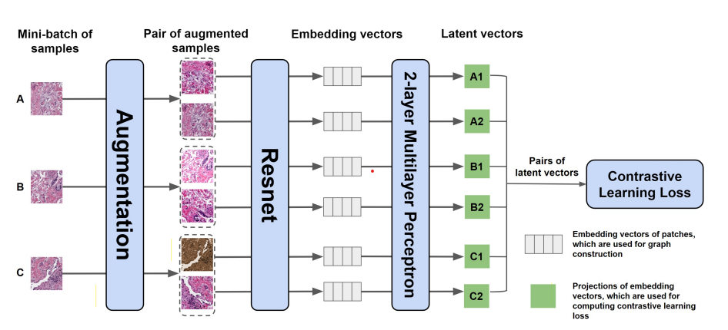
1. Contrastive Learning to Train the Feature Extractor
SimCLR
Resnet18 / Resnet50(pretrained and not pretrained)
Contrastive loss (NtXentLoss)
Yi Zheng, Rushin Gindra, Margrit Betke, Jennifer E.Beane, Vijaya B. Kolachama. “A deep learning based graph-transformer for whole slide image classification” (2021)
For constructing graph

Slide 5
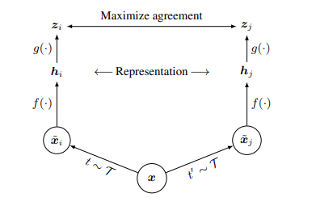
SimCLR Framework
Contrastive loss
x -> data augmentation -> xi and xj
f(.) -> neural network base encoder that extracts representation vectors from augmented data examples (ex: ResNet)
g(.) -> projection head that maps representation to the space where contrastive loss is applied

Slide 6
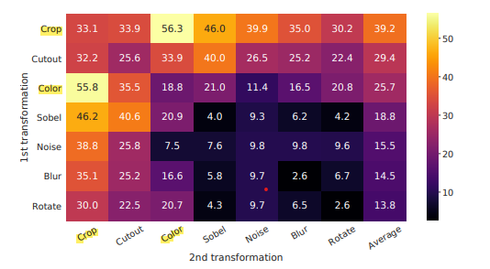
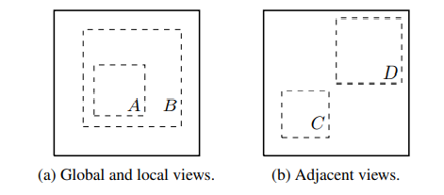
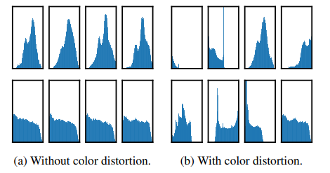
SimCLR Data Augmentation
Crop
Color distortion for different crops
Combination of Crop (with flip and resize) and color (distortion and gaussian blur) are the best for data augmentation in SimCLR

Slide 7
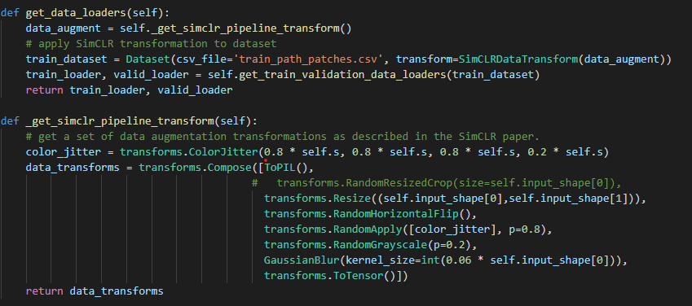
SimCLR Data Augmentation
S is the strength of color distortion
256,256
Gaussian kernel size = 0.06 * 256
Ting Chen, Simon Kornblith, Mohammad Norouzi, Geoffrey Hinton. “A Simple Framework for Contrastive Learning of Visual Representations (2020)

Slide 8
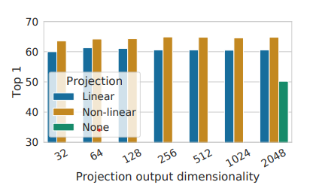
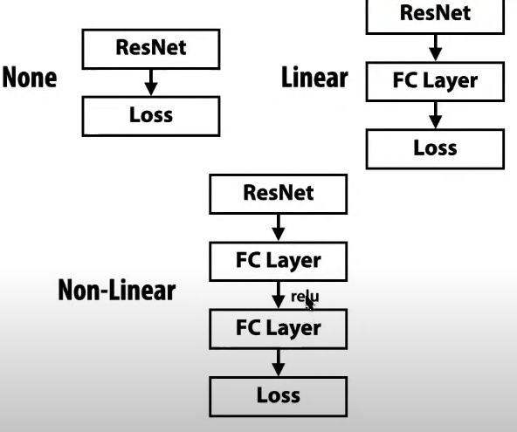
Projection Head
best
Ting Chen, Simon Kornblith, Mohammad Norouzi, Geoffrey Hinton.
“A Simple Framework for Contrastive Learning of Visual Representations (2020)

Slide 9
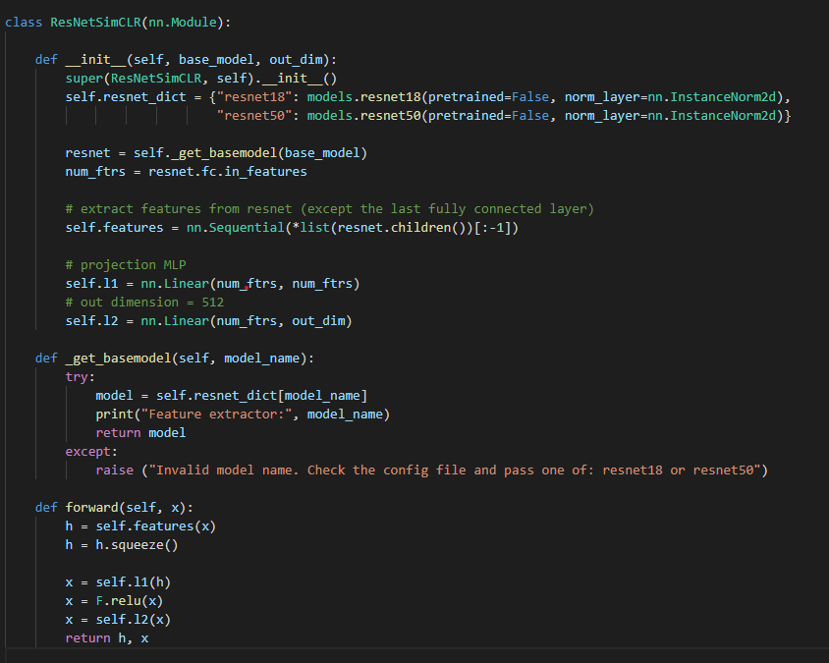
ResNet SimCLR (Non-Linear Projection)

Slide 10
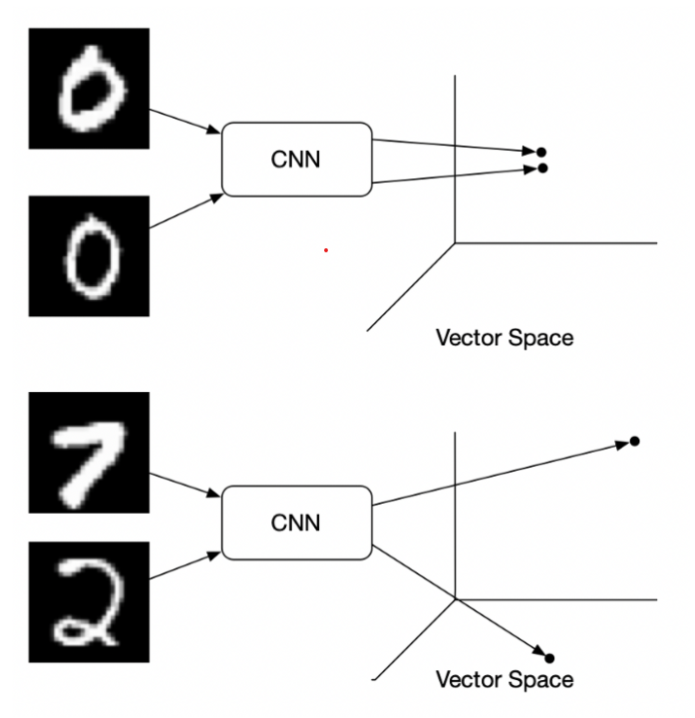
Contrastive Loss
Used for unsupervised learning
Key idea:
Same class -> similar embeddings
Different class -> dissimilar embeddings
Contrastive loss takes the output of network for a positive sample and calculate its distance to an example of the same class and contrasts that with the distance to the negative examples
Figure source: https://towardsdatascience.com/contrastive-loss-explaned-159f2d4a87ec

Slide 11
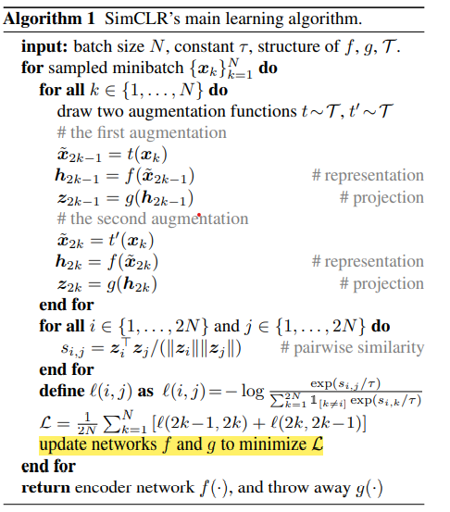

SimCLR Loss Function and Main Algorithm
For a positive pair (i,j):
Similarity of positive pairs
Similarity of negative pairs

Slide 12
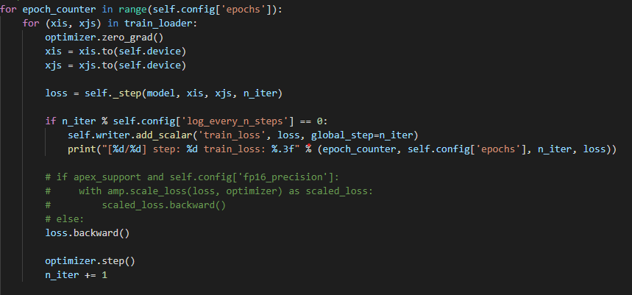
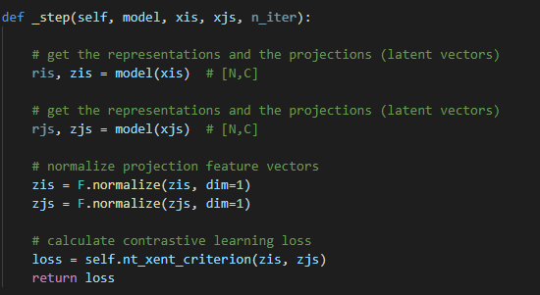
Training Loop

Slide 13
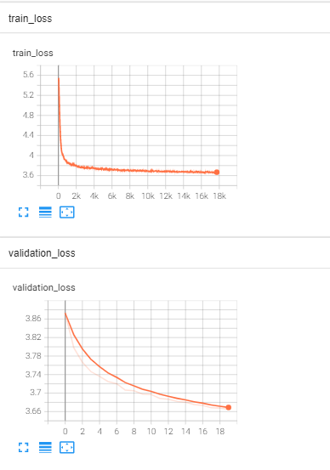
Dataset, Hyperparameters, and Result
Dataset: 126,264 colon patches (group into 283 WSI):
Training: 80,160 and validation: 8906 (70% from total dataset)
The rest of 30% will be used for validation and testing in the next
Step (training graph Transformer) -> not included in extracting patch
Feature to prevent from cheating
Epochs: 20
Batch Size: 128
Optimizer: Adam (learning rate: 1e-5, weight decay: 1e-7)
Scheduler: CosineAnnealingLR (T max: 20, last epoch: -1)
Loss: Contrastive Loss (NtXentLoss)
Total training time: ~5 hours (color) and 7.5 hours (crop resize & color)

Slide 14
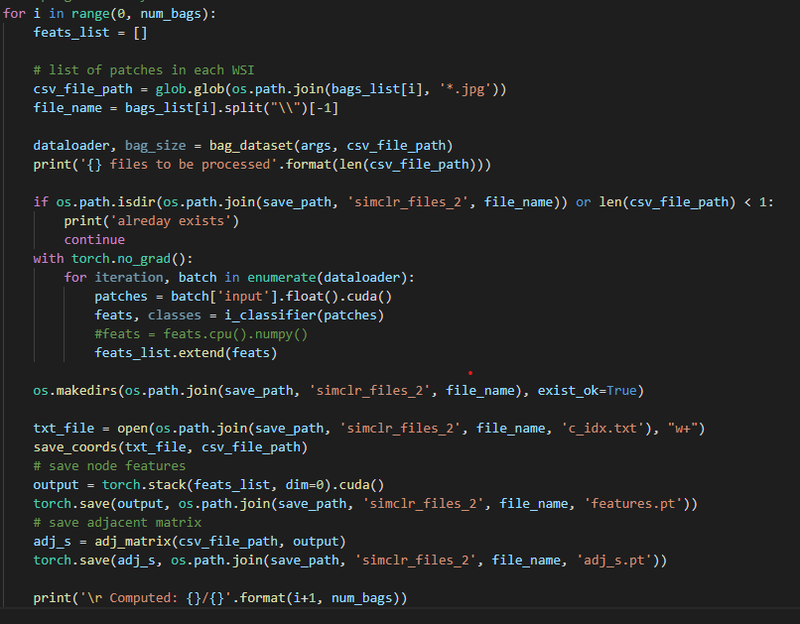
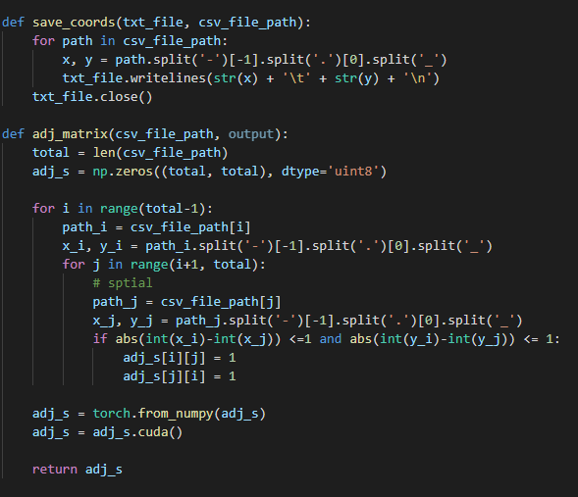
2. Constructing Graph
Looping for each WSI
Use the pretrained feature extractor from step 1
Use all of the dataset
Compute features for every patch in WSI
patch index width
and height position
Extract the feature of patches for each WSI using previous pretrained feature extractor
Making adjacency matrix

Slide 15
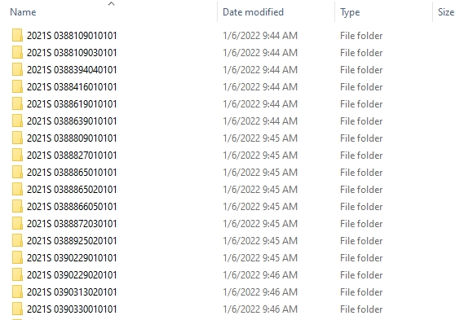
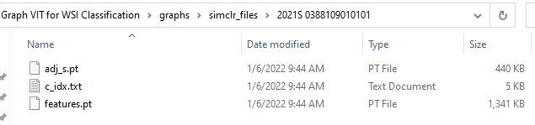
Result
Total time for constructing all of the WSI graphs: ~15 minutes

Slide 16
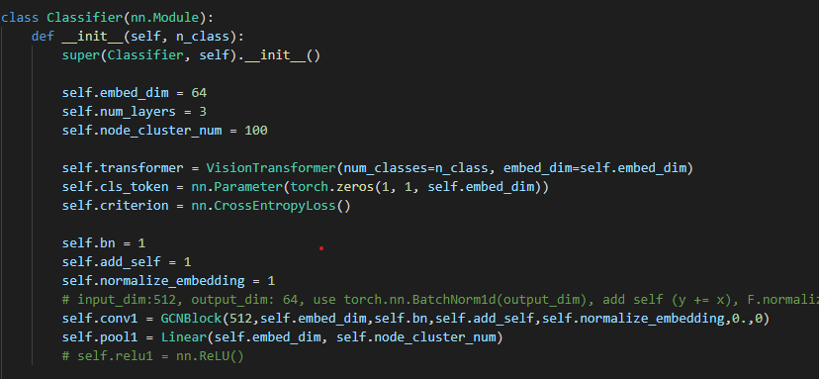
Graph Transformer Model
Graph Transformer consists of:
Graph convolutional layer: learning of node embeddings through propagating and aggregating needed information
Transformer layer (VIT): select the most significant nodes in the graph and aggregates information via the attention mechanism
Pooling layer: reduce dimensions of embedding dimension to node cluster number

Slide 17
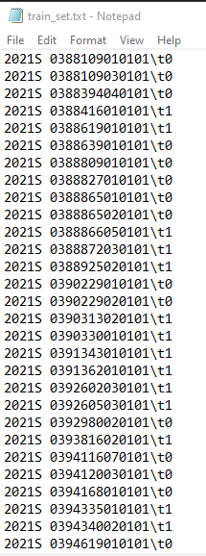
3. Training Graph Transformer
Referring to construct graph folders
Take features.pt, adj_s.pt, and label for each WSI for training graph Transformer
Note that the dataset has already been
splitted from 238 WSI into:
Training 199 WSI (70%)
Validation 42 WSI (15%)
Testing 42 WSI (15%)
Hyperparameters:
1. Epochs: 120
2. Optimizer: SGD (learning rate=4e-5, weight decay=4e-6)
3. Early stopping (patience=7, verbose=True)
4. Loss: CrossEntropyLoss()
label

Slide 18
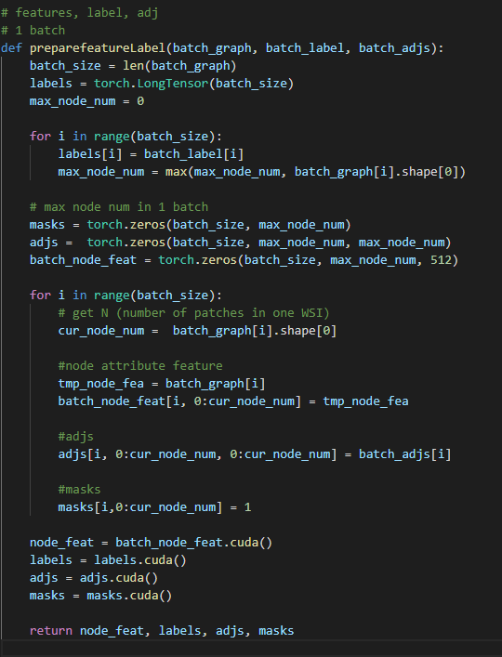
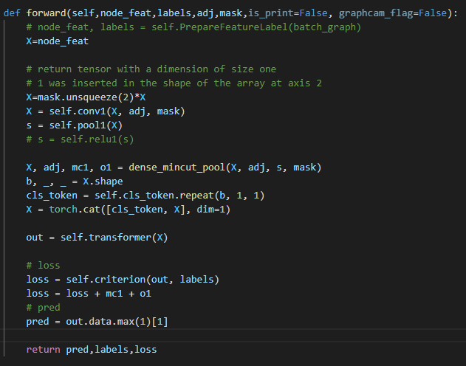
Graph Transformer Model
GCN
Reduced the number of input nodes
Pooling layer
Added cls token for classification
VIT

Slide 19
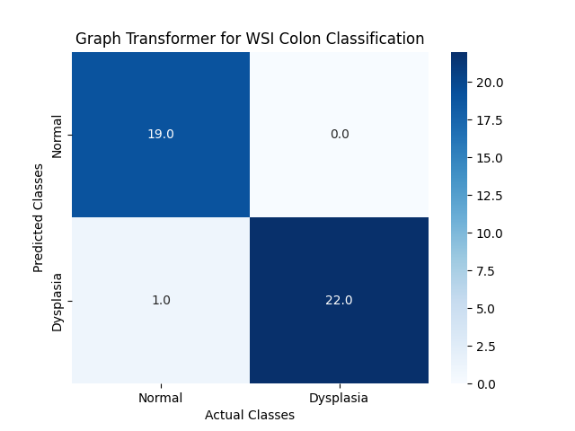
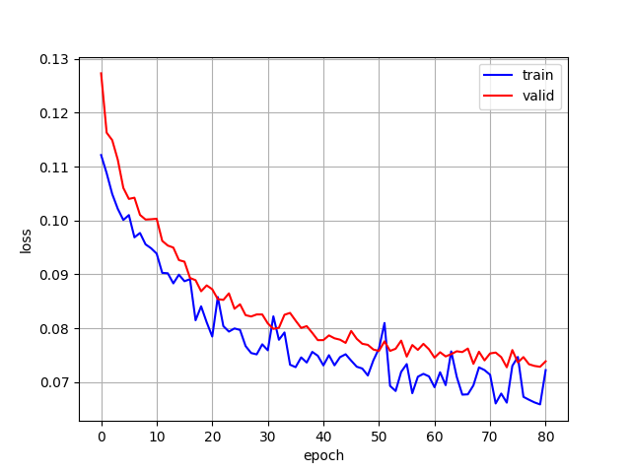
Results (Crop & Color Transformation)
1. Extracting Patch Feature with Resnet18 (pretrained=False, norm_layer=nn.InstanceNorm2d)
Training time: ~20 minutes (stops at epoch 80 because of early stopping)
Accuracy: 97.62%

Slide 20
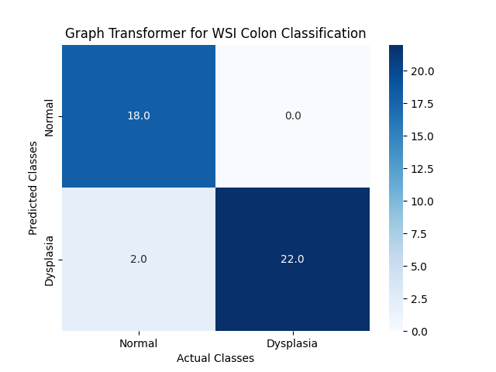
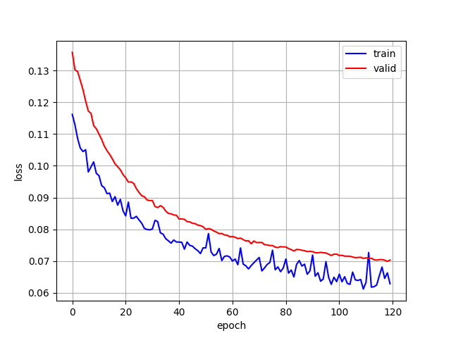
Results (Crop & Color Transformation)
2. Extracting Patch Feature with Resnet18 (pretrained=True)
Training time: ~30 minutes
Accuracy: 95.24%

Slide 21
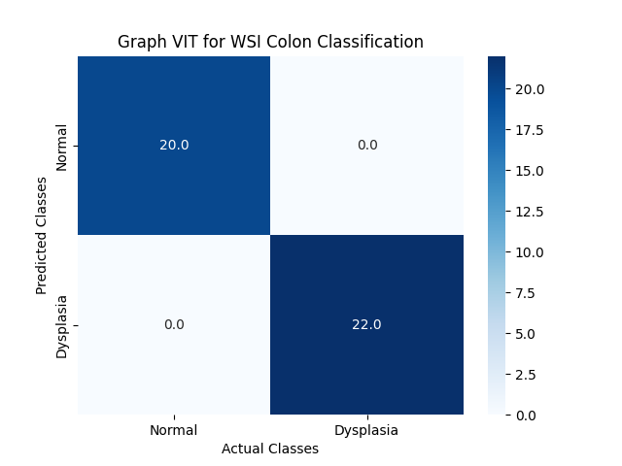
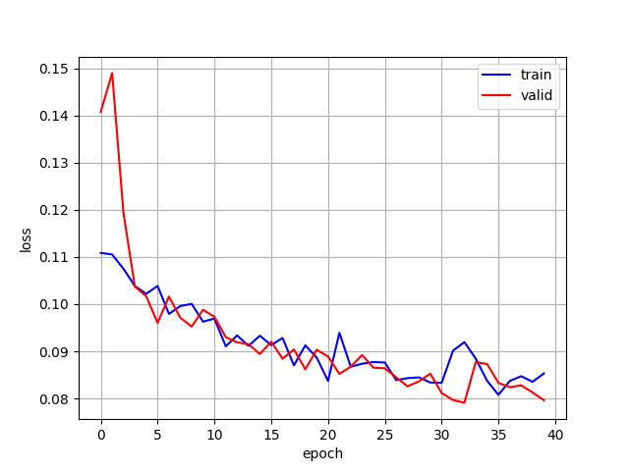
Results (Color Transformation)
3. Extracting Patch Feature with Resnet18 (pretrained=False, norm_layer=nn.InstanceNorm2d)
Training time: ~10 minutes (stops at epoch 40 because of early stopping)
Accuracy: 100%

Slide 22
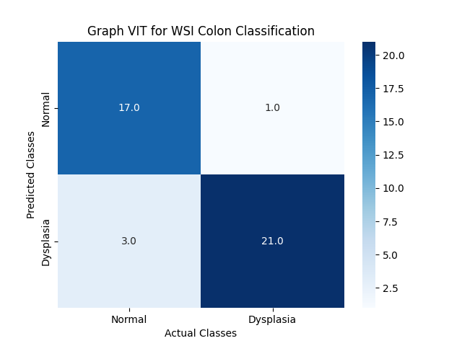
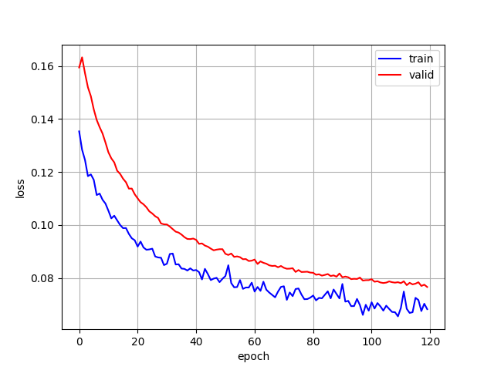
Results (Color Transformation)
4. Extracting Patch Feature with Resnet18 (pretrained=True)
Training time: ~30 minutes
Accuracy: 90.48%

Slide 23
Conclusion
This framework applies a feature extractor to generate a vector containing features and uses it to define information contained in an image patch, which is a node in the graph.
From the experiments, using only color transformation and not pretrained model with norm layer in Resnet18 gave the best result
Enables us to save training time -> reduces the node feature dimension from Wp×Hp×Cp to D (dimension of extracted feature vector)
For reference:
Task Name | Dataset | Total training time
VIT Colon Patch Classification | Big Star Data (54,968 patches) | 30.5 hours
Patch Feature Extractor + Graph Transformer for WSI Classification | Nov_False_PN_Cleaning (126, 264 patches = 283 WSI) | 5.5 – 8.5 hours (depends on transformation & model)

Slide 24
To Do
Do visualization part to identify regions that are highly associated with the WSI labels
Play around with changing neural network base encoder model (ex: ResNet18 -> ResNet50)
Change dataset and increase the number of classes (ex: 3 or 4 class classifier)

Slide 25


